Slide 1

Newton’s method for finding extrema in n dimensions

Slide 2
Introduction
In this topic, we will
  Describe using Newton’s method to find extrema of real-valued functions of a vector variable
  Review the concept of the gradient and the Jacobian of a vector-valued function of a vector variable
  Look at two examples
  Understand when to use this technique

Slide 3
Newton’s method
Here is a straight-forward idea:
  Apply Newton’s method to the gradient
Issue: You’re not sure if the point is a maximum, a minimum, or a saddle point
  A saddle point is where all partial derivatives are zero,
  but the function does not achieve an extremum

Slide 4
Newton’s method
At an extreme point, all the partial derivatives are zero
  Consequently, we must find a point such that
You will recall that

Slide 5
Newton’s method
Thus, becomes a system of n equations in n unknowns
  If f is a non-constant linear polynomial in u, then there are no solutions
  If f is a quadratic polynomial in u, then the gradient defines a system of linear equations: just use linear algebra
  Otherwise, the gradient is non-linear, so go back to our algorithm on Newton’s method in n dimensions: we can find a solution to g(u) = 0 by choosing an initial u₀ and iterating by solving and setting
In this case, our vector-valued function of a vector variable is the gradient of f, so solve and set

Slide 6
The Hessian
The Jacobian of the gradient of a real-valued function of a vector variable is called the Hessian of the function:
  We will continue to use the notation with the Jacobian
If the function is sufficiently differentiable,
the Hessian is symmetric

Slide 7
The Hessian
This is the Hessian of f :

Slide 8
The Hessian
Recall from applying Newton’s method to the derivative of a real-valued function of a real variable:
  A solution to f ⁽¹⁾(x) = 0 is
    A local minimum if f ⁽²⁾(x) > 0
    A local maximum if f ⁽²⁾(x) < 0
    Of unknown character if f ⁽²⁾(x) = 0
      That is, it could be a maximum, a minimum or a saddle point
The same applies here:
  A solution to is
    A local minimum if is positive definite
      That is, all eigenvalues are positive
    A local maximum if is negative definite
      That is, all eigenvalues are negative
    Of unknown character otherwise

Slide 9
Example
Consider the function
5x² + 6y² + 7z² + 2xy – 3yz – 28x + 6y – 3z + 1
  This is a quadratic polynomial in u, so we calculate:
  Thus, all we must solve is:
  Thus, , we note , and f (u) = –44

Slide 10
Example
Consider the function
5x² + 6y² + 7z² + 2xy – 3yz – 28x + 6y – 3z + 1
  Recall if you applied Newton’s method to a system of
  linear equations, it would converge after one iteration

Slide 11
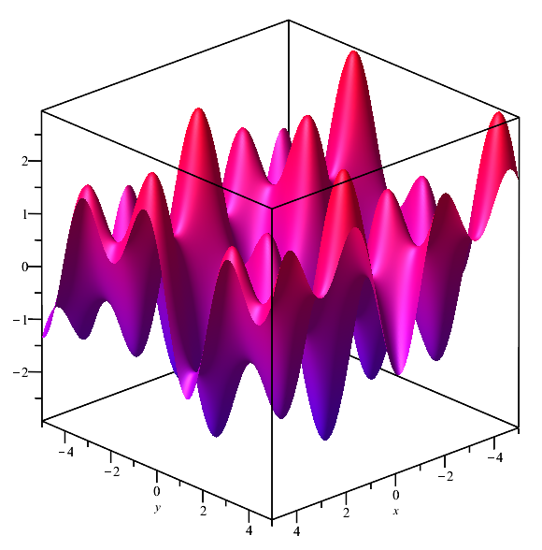
Example
Consider the function
sin(2x + 5) + sin(y – 3) + sin(x – 2y – 4)

Slide 12
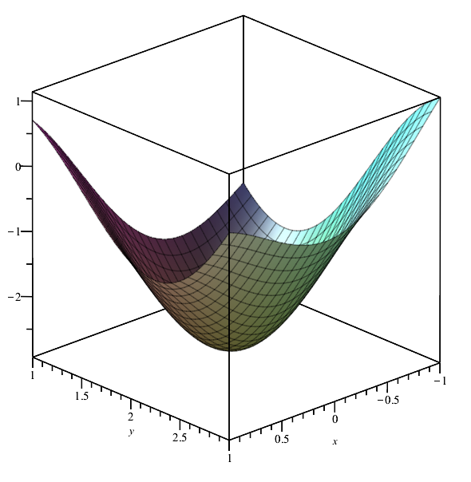
Example
There is a minimum close to x = –0.2 and y = 1.8
sin(2x + 5) + sin(y – 3) + sin(x – 2y – 4)

Slide 13
Example
We can calculate the gradient and Hessian:
sin(2x + 5) + sin(y – 3) + sin(x – 2y – 4)
  We find these are:

Slide 14
Example
Let us start with where f (u₀) = –2.9242734350
  Thus,
  Thus, solving yields
  Thus,
  and f (u₁) = –2.9313971404

Slide 15
Example
Continuing with where f (u₁) = –2.9313971404
  Thus,
  Thus, solving yields
  Thus,
  and f (u₂) = –2.9313971865

Slide 16
Example
Finally, with where f (u₂) = –2.9313971865
  Thus,
  Thus, solving yields
  Thus,
  and f (u₃) = –2.9313971865

Slide 17
Implementation
The images were made, and the results were verified in Maple
The Matlab code for the previous example was as follows:
>> f = @(u)( sin(2*u(1)+5) + sin(u(2)-3) + sin(u(1)-2*u(2)-4) );
>> df = @(u)( [2*cos(2*u(1)+5) + cos(u(1)-2*u(2)-4)
cos(u(2)-3) - 2*cos(u(1)-2*u(2)-4)] );
>> Jf = @(u)( [-4*sin(2*u(1)+5) - sin(u(1)-2*u(2)-4), 2*sin(u(1)-2*u(2)-4)
2*sin(u(1)-2*u(2)-4), -sin(u(2)-3) - 4*sin(u(1)-2*u(2)-4)] );
>> u = [-0.2 1.8]';
>> for i = 1:4
f(u)
df(u)
Jf(u)
du = Jf(u) \ -df(u)
u = u + du # overwrite 'u'
end

Slide 18
When to use?
If you are simulating a system you have modelled,
chances are you have mathematical descriptions of each of the components in your system
  Consequently, you can explicitly calculate both the gradient and the Hessian exactly
If you had a black-box function f for which you could not compute the partial derivatives,
other techniques are preferable

Slide 19
Summary
Following this topic, you now
  Are aware Newton’s method can be used to find extrema
  for real-valued functions of vector variables
  You understand that you must compute both the gradient and the Jacobian of the gradient (the Hessian)
  Understand that other techniques are preferable if the partial derivatives cannot be precisely
  Have seen two examples

Slide 20
References
[1] https://en.wikipedia.org/wiki/Newton%27s_method_in_optimization

Slide 21
Acknowledgments
None so far.

Slide 22



Colophon
These slides were prepared using the Cambria typeface. Mathematical equations use Times New Roman, and source code is presented using Consolas. Mathematical equations are prepared in MathType by Design Science, Inc.
Examples may be formulated and checked using Maple by Maplesoft, Inc.
The photographs of flowers and a monarch butter appearing on the title slide and accenting the top of each other slide were taken at the Royal Botanical Gardens in October of 2017 by Douglas Wilhelm Harder. Please see
https://www.rbg.ca/
for more information.

Slide 23
Disclaimer
These slides are provided for the ece 204 Numerical methods course taught at the University of Waterloo. The material in it reflects the author’s best judgment in light of the information available to them at the time of preparation. Any reliance on these course slides by any party for any other purpose are the responsibility of such parties. The authors accept no responsibility for damages, if any, suffered by any party as a result of decisions made or actions based on these course slides for any other purpose than that for which it was intended.

